Slide 1
Invest Wisely
Project 2 - Data Analytics
Michael, Mustafa, Neela, Thomas

Slide 2
The Story
Mike is a portfolio manager at Goldman Sachs. Every day, he and his team conduct research on potential stock investments.
Mike wants to upgrade the current research tools he uses and build something more catered to his type of analysis. He wants it all on one easy to use web page.
So begins his quest to a floor of the building that he’s never been… a floor with many puzzles, and many data analysts…

Slide 3
Design
To start, the team wants something easy to use and informative.
A user inputs a stock ticker symbol on our custom HTML page, and the program will then fetch, clean, and display the relevant stock data. The program will also save past user searches in a database.
After searching, a user should see on one page:
A historical price graph of the stock
A graph that compares the performance of the stock to the S&P500
A table with financial statistics about the stock
A collection of recent news articles about the company and its industry

Slide 4
Getting the Stock Data
IEX Trading provides a free stock market data API.
The team used d3.json to get an object with real-time and historical stock data.
Query urls for historical prices of the stock and of the S&P500 index:
url = `https://api.iextrading.com/1.0/stock/${stock}/batch?types=quote,news,chart&range=2y&last=5`
urlSP = `https://api.iextrading.com/1.0/stock/spy/batch?types=quote,news,chart&range=2y&last=1`
Query url for fundamental stock metrics to be displayed in table:
url=`https://api.iextrading.com/1.0/stock/${stock}/stats`
Notes:
Someone explain the query URL details

Slide 5
Displaying the Data
After fetching the stock data, the team used Javascript’s Plotly to graph the data. The x axis is the date, the y axis is the initial stock price.
The user can interact with the graph. Plotly allows the user to adjust the zoom, export it as a photo, and hover the mouse over the line to get more detailed price information.

Slide 6
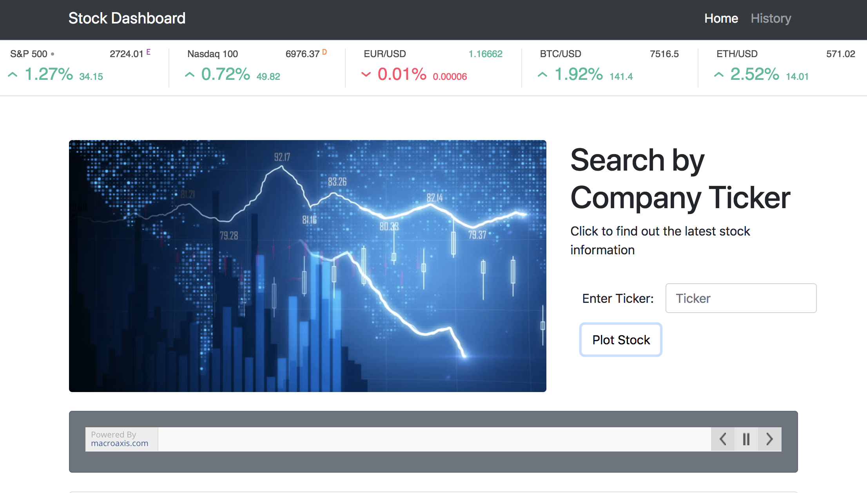
Home Page

Slide 7
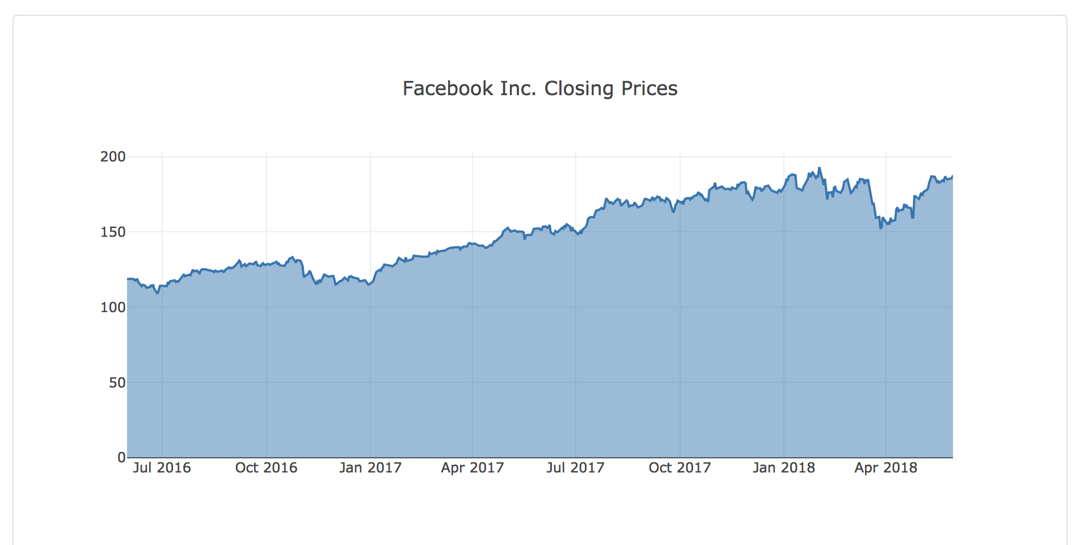
Price Chart
Notes:
Talk about ability to hover over line and see price, also to drill into a time frame by clicking and dragging a box over that part of the line. These are capabilities provided by Plotly

Slide 8
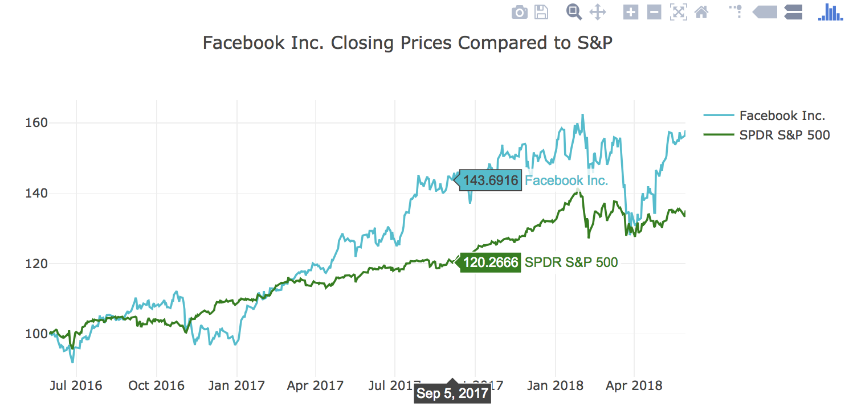
Compared to the S&P500
Notes:
State why the comparison is useful

Slide 9
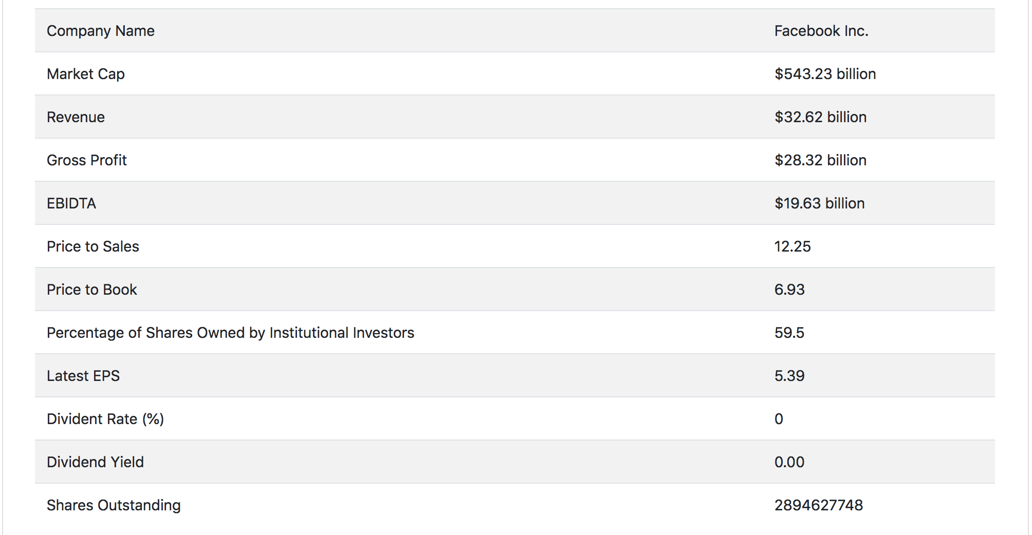
The Table

Slide 10
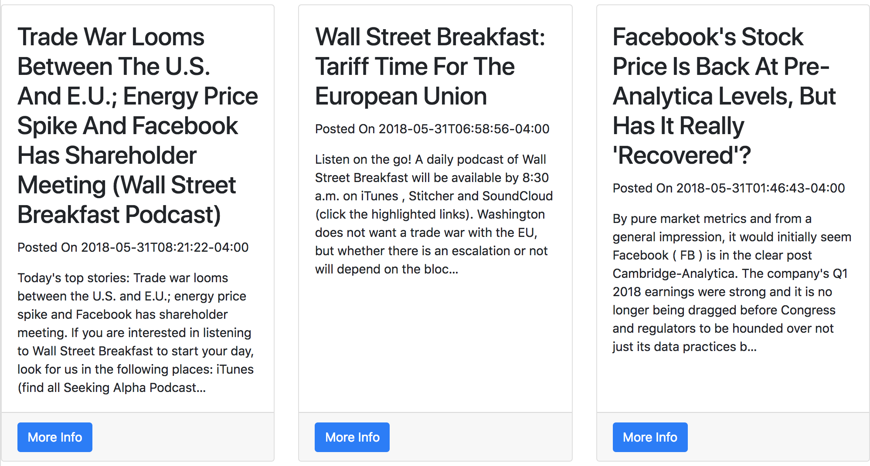
Recent News Articles
Notes:
Talk about how it’s convenient to have this info on the same page, rather than having to open a new tab and search news sites

Slide 11
Persistence Layer:
Operation : Read /Write in Mongo DB
1. we are auditing the customer search.
2. all the valid ticker information are stored in mongo DB.
3.stored ticker data attributes are
1) ticker name
2) company name
3) open value
4) close value
5) date
4) invalid ticker information are not stored in the database

Slide 12
Service Layer:
Initialize mongo client.
Implemented two REST services using Python as follows
1. Write :@app.route("/stocks/<stockInput>", methods=['GET'])
def stocks(stockInput):
2. Read : @app.route("/history")
def history():

Slide 13
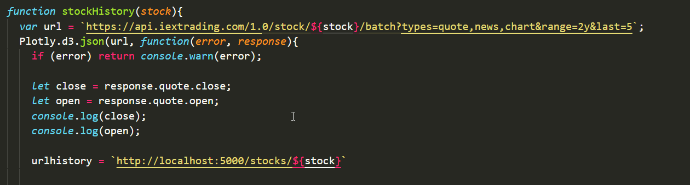
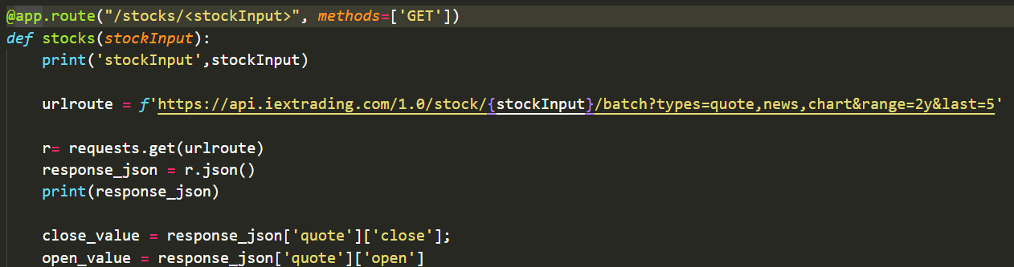
Write Operation:

Slide 14
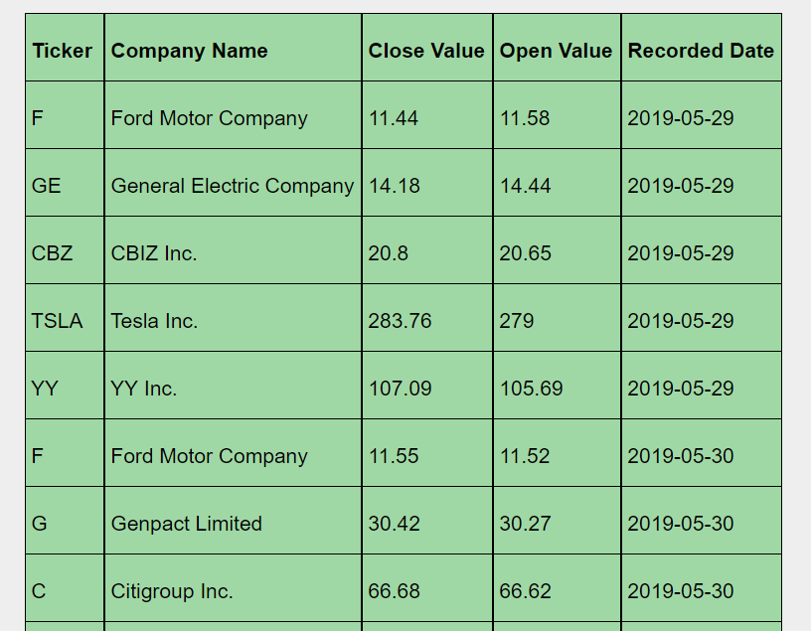
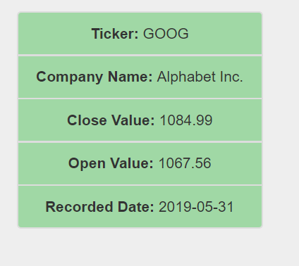
Read Operation:

Slide 15
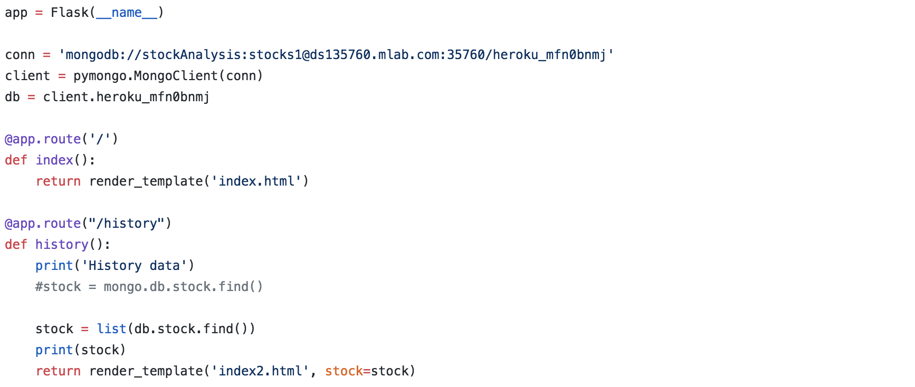
Flask API
The team’s Flask API allows the program to update the MongoDB and to query the stock market API on each search. It also renders the HTML page.

Slide 16
Hosting on Heroku
Mike doesn’t want his team to have to run this program locally on their machines. Ideally they can access it from any computer. For this reason, they hosted it on Heroku. This allows his team to access the tool from any web browser.
Notes:
Is the hosting set up in the app.py file?

Slide 17
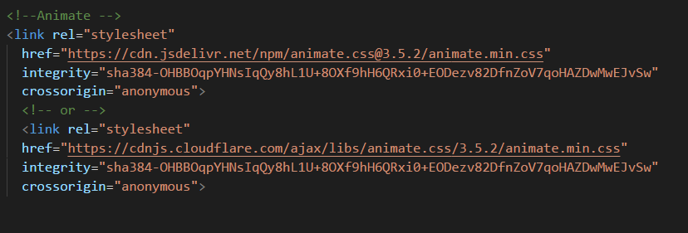
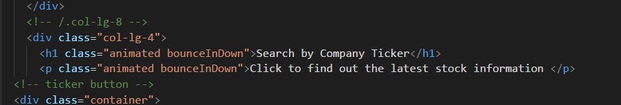
Animate.css Javascript Library
The team used a Javascript library called Animate.css to add animation features to various text elements. This makes the user experience a bit more enjoyable, which is important because stress contributes to poor judgement.

Slide 18
Opportunities for Improvement
The graph that compares the stock and S&P prices over time could also compare the stock with automatically selected comparable companies (ones in the same industry with similar market caps).
There could be some artistic, aesthetic improvements we could add that would make the user experience as stress-free as possible.
A user should be able to adjust the time horizon of the analysis (i.e. 7d, 6m, 1y, 5y).
Sometimes in order to have a competitive advantage in analysis, you need to consider data that others are not considering. An example of this could be social data about a company.

Slide 19
Conclusion

